Slide 1
Roanoke Disaster
TSA Eligibility Analysis
GROUP 3
Eric Jackson - Arslan Khan - Nina Abuzaid - Weston Martin - Kevon Mahban

Slide 2
Purpose and Agenda
Purpose - Provide predictive insights into TSA eligibility disaster dataset, highlighting key factors influencing eligibility and offering actionable recommendations to optimize resource allocation and disaster response
Agenda
Introduction
Predictive Modeling Results
Data Analysis
Power BI Dashboard
NLP Analysis
Conclusion and Q&A

Slide 3
Predictive Modeling Results
All Predictions via Decision Tree
Decision tree had best precision among all models
Results (TSA Eligibility)
1,048,575 Affected
122,802 Eligible:
11.71% of total
925,773 Ineligible:
88.23% of total
Most Important Factor : Repair Amount
Importance Score: .2988
Notes:
Parameters : max_depth = 10 | min_samples_leaf = 2 | criterion = ’entropy’ | min_samples_split = 10
Precision with historical data - 66.84%
11% is a good amount based on similar disasters, previous data has shown 38% receive eligibility for more disastrous events.

Slide 4
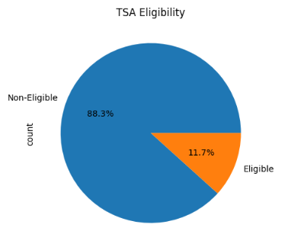
Data Analysis
TSA Eligibility Overview:
Pie Chart:
A pie chart showing the proportion of TSA-eligible vs. non-eligible families
Only about 12% of households are predicted to be TSA eligible.
Key Number:
Total non-eligible families: 925,773
Total eligible families: 122,802

Slide 5
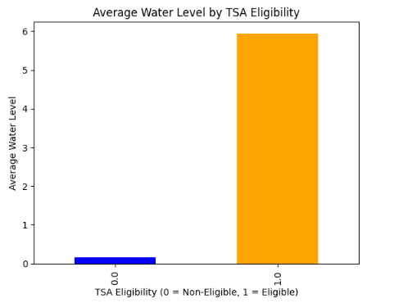
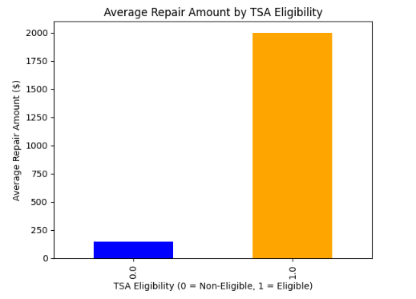
Data Analysis
Key Feature Analysis
Bar Chart for Water Level:
Eligible: 5.94 feet
Non-Eligible: 0.16 feet
Bar Chart for Repair Amount:
Eligible: $1,999
Non-Eligible: $143

Slide 6
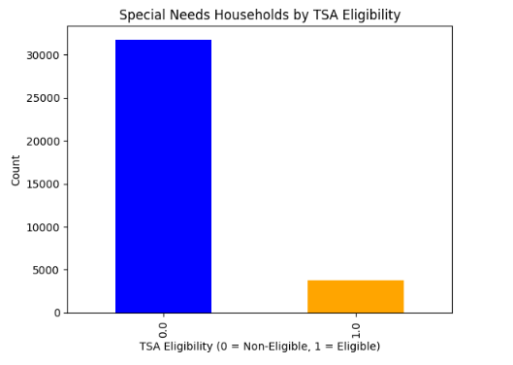
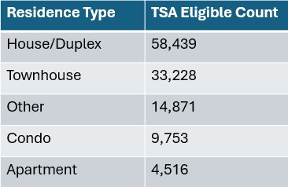
Data Analysis
Key Feature Analysis
Key Feature Analysis
Table for Residence Type:
House/Duplex: 58,439 eligible
Townhouse: 33,228 eligible
Other: 14,871 eligible
Bar Chart for Special Needs:
Eligible: 3,745 families
Non-Eligible: 31,769 families.

Slide 7
Power BI
Most affected town was Roanoke
314451 cases,
$114,757,125.01 in damages
Houses/duplex accounted for most damage done

Slide 8
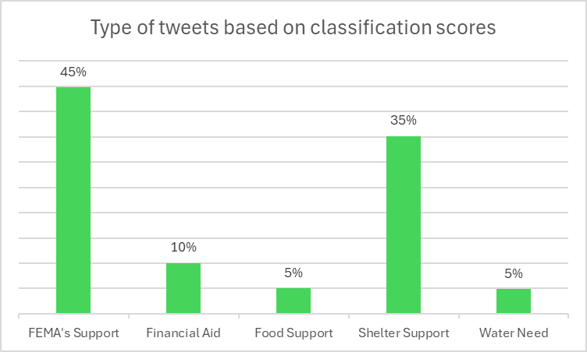
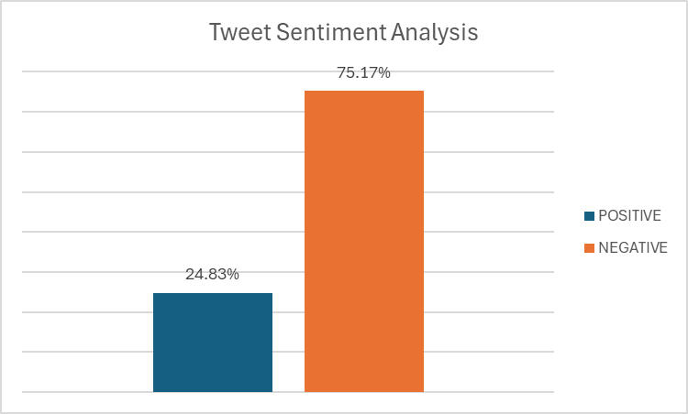
NLP Analysis
Zero Shot Classification
FEMA: 45%
Financial Aid: 10%
Food Support: 5%
Shelter Support: 35%
Water: 5%
Sentiment Analysis
POSITIVE: 75.17%
NEGATIVE: 24.83%

Slide 9
Conclusion and Q&A
Highlighted the most influential factors, such as repair costs and water levels, affecting TSA eligibility
Demonstrated the decision tree precision in predicting TSA eligibility and its implications for future analyses
Leveraged text analysis to understand public sentiment and categorize key support areas (e.g., shelter, financial aid)
Paved the way for data-informed approaches to improve emergency aid and disaster resilience

